Slide 1
Understanding Pointers
Buffer Overflow

Slide 2
Outline
Understanding Pointers
Buffer Overflow
Suggested reading
  Chap 3.10, 3.12

Slide 3
Pointers
Every pointer has a type
  If the object has type T
    A pointer to this object has type T *
  Special void * type
    Represents a generic pointer
  malloc returns a generic pointer
Every pointer has a value

Slide 4
Pointers
Pointers are created with the & operator
  Applied to lvalue expression
    Lvalue expression can appear on the left side of assignment
Pointers are dereferenced with the operator *
  The result is a value having the type associated with the pointer
Arrays and pointers are closed related
  The name of array can be viewed as a pointer constant
  ip[0] is equivalent to *ip

Slide 5
Pointer Arithmetic
Addition and subtraction
  p+i , p-i (result is a pointer)
  p-q (result is a int)
Referencing & dereferencing
  *p, &E
Subscription
  A[i], *(A+i)

Slide 6
Pointers can point to functions
void (*f)(int *)
f is a pointer to function
The function taken int * as argument
The return type of the function is void
Assignment makes f point to func
  f = func
Notice the precedence of the operators
  void *f(int *) declares f is a function
    (void *) f(int *)

Slide 7
Pointer Declaration
char **argv ;
int (*daytab)[13]
int (*comp)()
char (*(*x())[])()
  Function returning pointer to array[ ] of pointer to function returning char
char (*(*x[3])())[5]
  Array[3] of pointer to function returning pointer to array[5] of char

Slide 8
C operators
Operators Associativity
() [] -> . ++ -- left to right
! ~ ++ -- + - * & (type) sizeof right to left
* / % left to right
+ - left to right
<< >> left to right
< <= > >= left to right
== != left to right
& left to right
^ left to right
| left to right
&& left to right
|| left to right
?: right to left
= += -= *= /= %= &= ^= != <<= >>= right to left
, left to right
Note: Unary +, -, and * have higher precedence than binary forms

Slide 9
Parameter Passing
Call by value
  f(xp)
Call by reference
  f(&xp)

Slide 10
Out-of-Bounds Memory References
1 /* Implementation of library function gets() */
2 char *gets(char *s)
3 {
4 int c;
5 char *dest = s;
6 int got_char = 0 ; /Has at least one character been read? */
7 while ((c = getchar()) != ’\n’ && c != EOF) {
8 *dest++ = c; /* No bounds checking */
9 gotchar = 1;
10 }

Slide 11
Out-of-Bounds Memory References
11 *dest++ = ’\0’; /* Terminate String */
12 if (c == EOF && !gotchar)
13 return NULL; /* End of file or error */
14 return s;
15 }
16
Type ctrl-d at keyboard means EOF

Slide 12
Out-of-Bounds Memory References
14 /* Read input line and write it back */
15 void echo()
16 {
17 char buf[8]; /* Way too small ! */
18 gets(buf);
19 puts(buf);
20 }

Slide 13
Out-of-Bounds Memory References
1 echo:
2 pushl %ebp Save %ebp on stack
3 movl %esp, %ebp
4 pushl %ebx Save %ebx
5 subl $20, %esp Allocate 20 bytes on stack
6 leal -12(%ebp), %ebx Compute buf as %ebp-12
7 movl %ebx, (%esp) Store buf at top of stack
8 call gets Call gets
9 movl %ebx, (%esp) Store buf at top of stack
10 call puts Call puts
11 addl $20, %esp Deallocate stack space
12 popl %ebx Restore %ebx
13 popl %ebp Restore %ebp
14 ret Return

Slide 14
Out-of-Bounds Memory References
Return address
Saved %ebp
Saved %ebx
[7] | [6] | [5] | [4]
[3] | [2] | [1] | [0]
Stack frame
for caller
%ebp
Stack frame
for echo
buf

Slide 15
Out-of-Bounds Memory References
Return address
Saved %ebp
[11] | [10] | [9] | [8]
[7] | [6] | [5] | [4]
[3] | [2] | [1] | [0]
Stack frame
for caller
%ebp
Stack frame
for echo
buf

Slide 16
Out-of-Bounds Memory References
Return address
[15] | 1[4] | [13] | [12]
[11] | [10] | [9] | [8]
[7] | [6] | [5] | [4]
[3] | [2] | [1] | [0]
Stack frame
for caller
%ebp
Stack frame
for echo
buf

Slide 17
Out-of-Bounds Memory References
[19] | [18] | [17] | [16]
[15] | 1[4] | [13] | [12]
[11] | [10] | [9] | [8]
[7] | [6] | [5] | [4]
[3] | [2] | [1] | [0]
Stack frame
for caller
%ebp
Stack frame
for echo
buf

Slide 18
Out-of-Bounds Memory References
1 /* This is very low-quality code.
2 It is intended to illustrate bad programming practices.
3 See Problem 3.43. */
4 char *getline()
5 {
6 char buf[8];
7 char *result;
8 gets(buf);
9 result = malloc(strlen(buf));
10 strcpy(result, buf);
11 return result;
12 }

Slide 19
Out-of-Bounds Memory References
1 080485c0 <getline>:
2 80485c0: 55 push %ebp
3 80485c1: 89 e5 mov %esp,%ebp
4 80485c3: 83 ec 28 sub $0x28,%esp
5 80485c6: 89 5d f4 mov %ebx,-0xc(%ebp)
6 80485c9: 89 75 f8 mov %esi,-0x8(%ebp)
7 80485cc: 89 7d fc mov %edi,-0x4(%ebp)
Diagram stack at this point
8 80485cf: 8d 75 ec lea -0x14(%ebp),%esi
9 80485d2: 89 34 24 mov %esi,(%esp)
80485d5: e8 a3 ff ff ff call 804857d <gets>
Modify diagram to show stack contents at this point

Slide 20
Out-of-Bounds Memory References
2 push %ebp
3 mov %esp,%ebp
4 sub $0x28,%esp
5 mov %ebx,-0xc(%ebp)
6 mov %esi,-0x8(%ebp)
7 mov %edi,-0x4(%ebp)
Diagram stack at this point
8 lea -0x14(%ebp),%esi
9 mov %esi,(%esp)
call 804857d <gets>
08 04 86 43
Return address
bf ff fc 94 | %ebp
0x01 | %ebx
0x02 | %edi
0x03 | %esi

Slide 21
Out-of-Bounds Memory References
%ebp
2 push %ebp
3 mov %esp,%ebp
4 sub $0x28,%esp
5 mov %ebx,-0xc(%ebp)
6 mov %esi,-0x8(%ebp)
7 mov %edi,-0x4(%ebp) Diagram stack at this point
8 lea -0x14(%ebp),%esi
9 mov %esi,(%esp)
call 804857d <gets>
08 04 86 43
bf ff fc 94
02
03
01
Return address
Saved %ebp
Saved %edi
Saved %esi
Saved %ebx
bf ff fc 94 | %ebp
0x01 | %ebx
0x02 | %edi
0x03 | %esi

Slide 22
Out-of-Bounds Memory References
%ebp
2 push %ebp
3 mov %esp,%ebp
4 sub $0x28,%esp
5 mov %ebx,-0xc(%ebp)
6 mov %esi,-0x8(%ebp)
7 mov %edi,-0x4(%ebp)
8 lea -0x14(%ebp),%esi
9 mov %esi,(%esp)
call 804857d <gets>
Modify diagram to show stack contents at this point
08 04 86 00
33 32 32 30
39 38 37 36
35 34 33 32
31 30 39 38
37 36 35 34
33 32 31 30
Return address
Saved %ebp
Saved %edi
Saved %esi
Saved %ebx
bf ff fc 94 | %ebp
0x01 | %ebx
0x02 | %edi
0x03 | %esi
“012345678901234567890123”

Slide 23
Malicious Use of Buffer Overflow
Stack
after call to gets()
void foo(){
bar();
...
}
return
address
A
foo stack frame
void bar() {
char buf[64];
gets(buf);
...
}
B
data
written
by
gets()
pad
exploit
code
bar stack frame
B

Slide 24
Malicious Use of Buffer Overflow
Input string contains byte representation of executable code
Overwrite return address with address of buffer
When bar() executes ret, will jump to exploit code

Slide 25
The Famous Internet Worm of November 1988
To gain access to many of the computers across the Internet
  4 different ways
  One was a buffer overflow attack on the fingerd
Hundreds of machines were effectively paralyzed
The author of the worm was caught and prosecuted. He was sentenced to
  3 years probation
  400 hours of community service
  and a $10,500 fine

Slide 26
The Famous Internet Worm of November 1988
Steps
  invoked finger with an appropriate string
  Made a process at a remote site have a buffer overflow
  executed code that gave the worm access to the remote system
  The worm replicated itself and consumed virtually all of the machine’s computing resources

Slide 27
Stack Randomization
Making a vulnerability to have a stack overflow
  Try the right string on your own computer
  The string contains
    The exploit code and
    The address of this code
  Put the string to the remote computer
Stack randomization makes it hard to determine the address of the exploit code

Slide 28
Stack Randomization
1 int main() {
2 int local;
3 printf("local at %p\n", &local);
4 return 0;
5 }
Running the code 10,000 times on a Linux (maybe 2.6.16) machine in 32-bit mode
the addresses ranged from
  0xff7fa7e0 to 0xffffd7e0
  A range of around 2²³

Slide 29
Stack Randomization
Running in 64-bit mode on the newer machine
The addresses ranged from
  0x7fff00241914 to 0x7ffffff98664
  A range of nearly 2³²
Address-space layout randomization (ASLR)
  each time a program is run
  different parts of the program are loaded into different regions of memory
    code, data, heap data, library code, stack

Slide 30
Stack Randomization
Nop sled
  a program “slides” through a long sequence of “nop”
Nop
  no operation instruction
Include a “nop sled” before the actual exploit code
  If insert 256-byte nop sled
  Need to guess 2¹⁵ starting addresses (no too much) for 32-bit machine
  Still have too many 2²⁴ guesses

Slide 31
Stack Corruption Detection
Return address
Saved %ebp
Saved %ebx
Canary
[7] | [6] | [5] | [4]
[3] | [2] | [1] | [0]
Stack frame
for caller
%ebp
Stack frame
for echo
buf

Slide 32
Stack Corruption Detection
1 echo:
2 pushl %ebp
3 movl %esp, %ebp
4 pushl %ebx
5 subl $20, %esp
6 movl %gs:20, %eax Retrieve canary
7 movl %eax, -8(%ebp) Store on stack
8 xorl %eax, %eax Zero out register
9 leal -16(%ebp), %ebx Compute buf as %ebp-16
10 movl %ebx, (%esp) Store buf at top of stack
11 call gets Call gets
12 movl %ebx, (%esp) Store buf at top of stack
13 call puts Call puts

Slide 33
Stack Corruption Detection
14 movl -8(%ebp), %eax Retrieve canary
15 xorl %gs:20, %eax Compare to stored value
16 je .L19 If =, goto ok
17 call __stack_chk_fail Stack corrupted!
18 .L19: ok:
19 addl $20, %esp Normal return ...
20 popl %ebx
21 popl %ebp
22 ret
%gs:20
  Segmented addressing which appeared in 80286 and seldom used today
  It is marked as read only

Slide 34
Limiting Executable Code Regions
Page
  4k bytes
  As a protected unit by OS
  Should be marked as “readable”, “writable” and “executable”
    3 bits are required
Originally Intel merged the “readable” and “executable” into one
  The exploit code in the stack can be executed
AMD introduced “NX” in X86-64
  Now there 3 bits
  How about “JIT”?

Slide 35
Code Reuse Attack
Return-oriented Programming
  Find code gadgets in existed code base (e.g. libc)
  Push address of gadgets on the stack
  Leverage ‘ret’ to connect code gadgets
  No code injection
Solutions
  Return-less kernels
  Heuristic means
New Attacks: Jump-oriented
  Use gadget as dispatcher
Address C
Address B
Address A
return addr
0101011010
saved ebp
A
0101011010
B
0101011010
C
0101011010

Slide 36
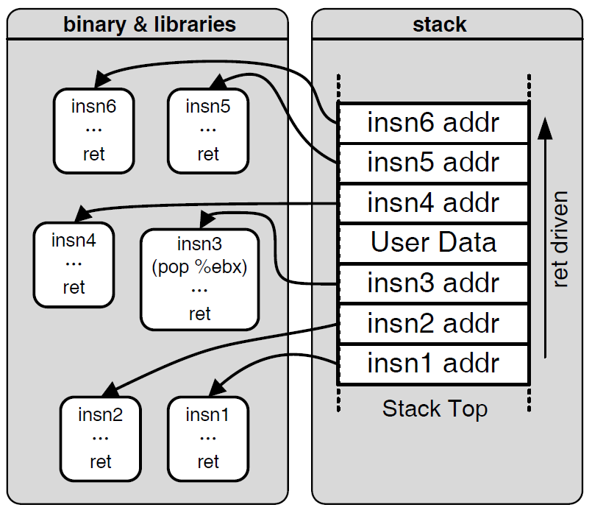

Motivation: Code Reuse Attack

